Slide 1
Decreasing Preventable Readmissions Through Prognostic modeling
Philip Hagedorn, MD
Gabrielle Choonoo

Slide 2
Overview
The problem
The proposed solution
Identification of patients at high-risk for readmission
Downstream organizational implications
Barriers/Limitations to this approach
Payoff

Slide 3
Readmissions: A brief overview
Definition: more than one admission to the hospital <30 days
Unpreventable
Progression of disease
Previously unrecognized/undiagnosed problem
Unrelated/new problem
Preventable
Inadequate follow-up
Impaired access to the transportation
Poor social support system
Noncompliance with medications/recommendations
Difficulty navigating medical system

Slide 4
Why spend effort and time on preventing readmissions?
Decrease cost to org
Preventable readmissions lead to increased org costs
Occupied patient beds lowers system capacity
CMS-related penalties
Prevented readmission episodes represent area for improved revenue
Transition to bundled care optimizes further revenue
Here @ KPNW
Current readmissions account for ~15% of hospital-based encounters
(n=~35k encounters)

Slide 5
Identifying patients @ high-risk for readmission
2010 - Van Walraven et al developed scoring tool to risk stratify hospitalized patients
Score based on 4 factors
L – Length of Stay
A – Acuity of admission (ED vs clinic, elsewhere_
C – associated comorbidities
E – Number of ED visits in 6 mo prior to admissions

Slide 6
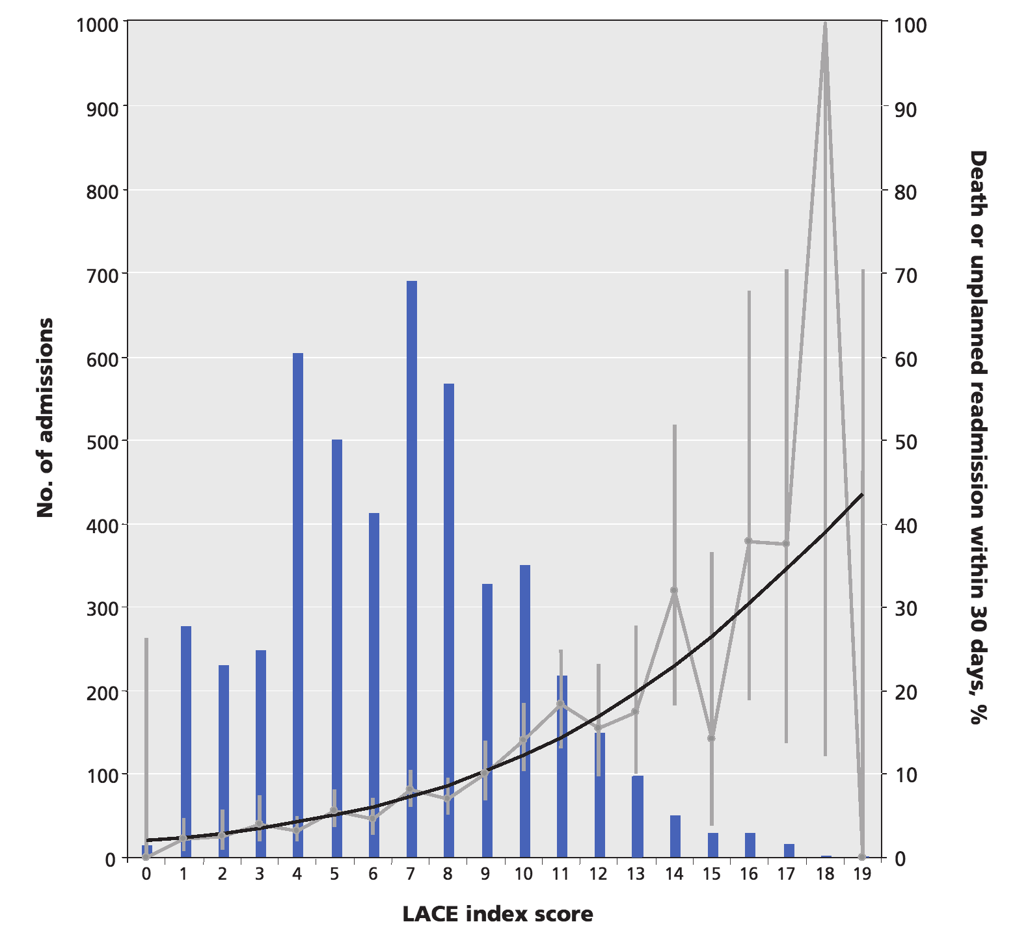
LACE stratification
Development team found model was able to quantify risk of death and unplanned readmission within 30 days of discharge from the hospital.

Slide 7
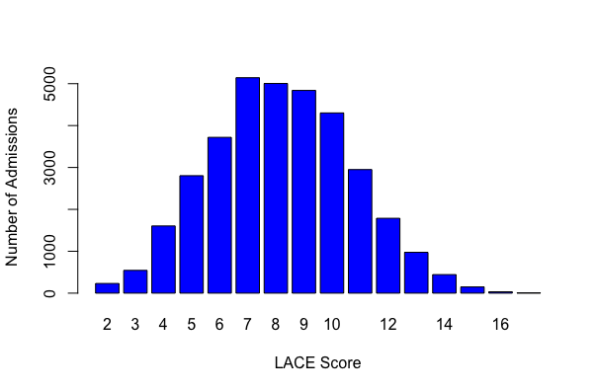
Prototyped Model @ KPNW
Historic
System
Data
Length of Stay
(from current encounter)
Acuity of Admission
(Admission source for current encounter)
LACE SCORE
Comorbidities
(Patient’s problem list, currently only
includes CAD & CHF)
 | No Readmit | readmit
Prediction of No Readmit | 83.5% | 1.2%
Prediction of Readmit | 14.6% | 0.65%
ED Utilizations
(Past encounters in patient chart)

Slide 8
Limitations of prototype Model
Incomplete comorbidity implementation
Only currently includes diagnoses associated with CAD and CHF
Other comorbidities included in the van Walraven model include: dementia, depression, COPD, Asthma, Diabetes, Hepatic disease, Neoplastic disease, etc
Poor positive predictive value
Cannot actively determine where to spend resources based on model as currently implemented

Slide 9
Opportunities given current constraints
High negative predictive value means ancillary discharge efforts can be diverted from low-risk cases
Resources for further development/refinement should lead to improvement in screening characteristics meaning efforts can be actively directed to high-risk case
Pre-discharge identification of Patient @ high-risk for readmission
Directed resources before and after discharge
- Triaged follow-up with specialist & PMD
- Ride provision
- Home health visit
- Patient leaves with medications in-hand

Slide 10
Next steps
Champions Needed
Physician documentation, discharge
Hospital social work, care management
Home health network
Scheduling capacity @ specialist & PMD
Resource deployment
Further development to accurately capture and score additional comorbidity data
Investigation of other covariates which may/may not improve characteristics of the model
Development and deployment in production environment
Education of provider workforce

Slide 11
Future state: A learning readmission prevention system
High Risk Discharge
Identified
Readmit mitigation via interventions
Readmission identified as failure
Systematic study of failure
Application of learnings to readmit mitigation

Slide 12
Conclusions
LACE model can help KPNW direct care management resources to hospitalized patients @ high-risk for readmission
Current prototype in incompletely implemented and significantly flawed
Still have negative predictive value which could be of operational use
Further development has potential to significantly improve model characteristics and subsequent gains to organization
In addition to development resources need buy-in and champions across org to assist with implementation

